Slide 1
Aws console

Slide 2
agenda
Short introduction
Access management - iam
Networking - VPC
Compute - EC2
Load balancing - elb
Database – RDS/DynamoDB
Storage - S3
Automation - cloudformation
DEMo
Questions

Slide 3
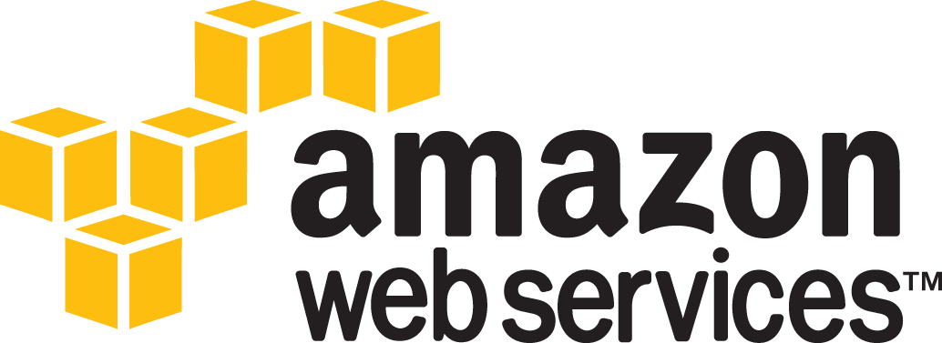
About AWS
What is AWS? – Amazon Web Services(AWS) is a cloud service from Amazon, which provides services in the form of building blocks, these building blocks can be used to create and deploy any type of application in the cloud.
These services or building blocks are designed to work with each other, and result in applications which are sophisticated and highly scalable.
Benefits:
Agility
Elasticity
Cost savings
Global availability

Slide 4
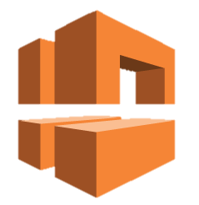




AWS CONSOLE
AWS Management Console. AWS Management Console is basically a web application that allows users to access and manage any of the resources/services running on the AWS infrastructure. It also provides information related to billing and more.
Following is the list of some of the tasks that you can perform using AWS Management Console:
Finding and accessing services
Creating and deleting service shortcuts
Selecting regions for region-specific services
Getting billing information

Slide 5

Access management - IAM
Amazon IAM (Identity and Access Management) is used for restricting the access to various services, only allowing specific users / roles. IAM users can be assigned to user groups, for easier management of permissions. Roles can be assigned to other AWS resources.
Key concepts:
Users
User groups
Roles
Policies

Slide 6
Networking - VPC
Amazon VPC (Virtual Private Cloud) provides a versatile networking capability in AWS meaning it provides built-in security and a private cloud. VPC comes free with EC2.
The default VPC is a public VPC. It is designed to make it easy to get going with EC2/RDS and other related AWS services. It has an internet gateway and public subnets with corresponding route table.
The non default VPC can be created so that different parts of the network are kept private. It allows to set a preferred CIDR block range and subnet sizes.
Key concepts:
Subnet
Availability Zones
Internet gateway
NAT gateway
Elastic IPs
Etc.

Slide 7
COMPUTE – EC2
EC2 (Elastic Compute Cloud) is a compute service offered by AWS which provides resizable compute capacity in the cloud.
In simpler words, you get a server with custom compute capacity, and this capacity can be adjusted according to your needs. You can also distribute incoming application or network traffic across multiple targets using a Load Balancer. You can also scale instances automatically, in order to withstand periods of increased demand.
What do you need?
IAM account – so that you can access the AWS console or use AWS CLI
Key Pair – SSH keys to connect to the new instance, because AWS Linux instances don’t use passwords to login to them
VPC – a default or non default virtual private network
Security group – acts as a firewall for controlling both inbound and outbound traffic

Slide 8
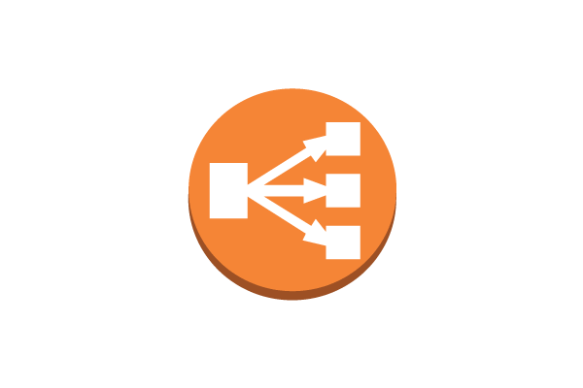
Load balancing – elb
Amazon Elastic Load Balancer (ELB) automatically distributes incoming application traffic across available application servers. This is typically done via listeners, which can route the traffic to different applications, depending on the defined rules. The servers are organized in target groups.
Key concepts:
Listeners
Rules
Target Groups

Slide 9
Database - RDS
To operate and scale MySQL, Oracle, SQLServer or PostgreSQL servers on AWS, Amazon RDS is used.
RDS pricing is based on the instance operating hours and storage amount.
Benefits:
Easy to administer
Highly scalable
Available and durable
Fast
Secure
Inexpensive

Slide 10

Database - DynamoDB
Amazon DynamoDB is a key-value and document database that delivers single-digit millisecond performance at any scale. It's a fully managed, durable database with built-in security, backup and restore, and in-memory caching for internet-scale applications. DynamoDB can handle more than 10 trillion requests per day and can support peaks of more than 20 million requests per second.
Benefits:
Performance at scale
No servers to manage
Enterprise ready

Slide 11
Storage - S3
Amazon S3 (Simple Storage Service) is a storage offering of AWS that can store any amount of storage which is required. It is used for various reasons like content storage, backup, archiving and disaster recovery and also data analysis storage. S3 has multiple storage classes, which provide optimized cost in relation to data access requirements.
Main concepts:
Buckets – containers for objects
Objects – fundamental entities stored in buckets
Keys – unique identifiers for objects stored in buckets
Regions – the location where the bucket is stored. Used to optimize latency, minimize costs
Requests can be made via REST api, SDKs or over IPv6

Slide 12

Automation - Cloudformation
Amazon CloudFormation is an Infrastructure as Code tool built within the AWS ecosystem. It allows resources to be created programmatically, by using YAML / JSON files. This aids in team collaboration (as multiple people can contribute to the configuration file), but it also has benefits when it comes to automating infrastructure deployments.
Main concepts:
Templates
Stacks

Slide 13
bibliography
https://www.edureka.co/blog/what-is-aws/
https://intellipaat.com/blog/what-is-amazon-web-services-aws/
https://aws.amazon.com/documentation/gettingstarted/
https://docs.aws.amazon.com/AmazonECS/latest/developerguide/Welcome.html
https://aws.amazon.com/dynamodb/
https://docs.aws.amazon.com/elasticloadbalancing/latest/userguide/what-is-load-balancing.html?icmpid=docs_elbv2_console

